Slide 1


Welcome to my Presentation
Map and Climate modelling in Civilization 5

Slide 2


Introduction
Looking through Datatonic and Google Cloud Platform for data sources.
Found Google Maps Platform.
Access to elevation data reminded me of creating maps in Civilization 5.

Slide 3

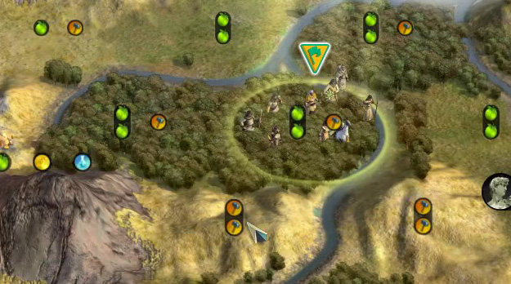

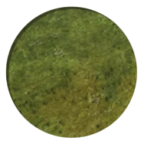
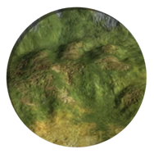
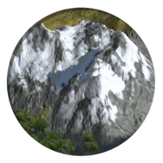
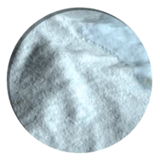
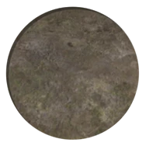
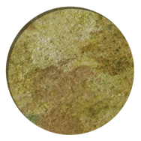
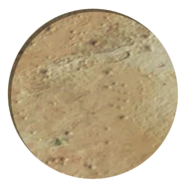
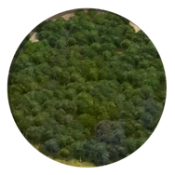
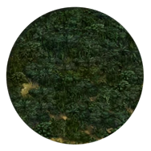
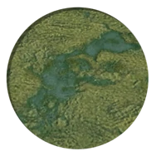
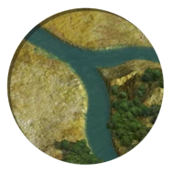
Start off in 4000BC as a tribe of a historic peoples.
Game is not super realistic but it’s important to have an interesting and believable map.
Tiles on a map defined by elevations:
Then general climate (temperature and rainfall).

Slide 4
Project Goals
Map:
Everything in a set place.
Earth map most commonly played.
Mapscript:
Randomly generate elevations and climate to make ‘realistic map’.
A lot of people have added to the mapscripts over time to try and improve them.
2. Can we test and improve the existing mapscript using real data?
1. Can we make a real Earth map using real data?

Slide 5
Elevation Data
Accessed through Google’s API
Need API key from your GCP account and then locations as lat/long pairs.
Civ map must be rectangular shaped - we can split map into an even grid.
It’s also a hex grid, so slightly more complicated.
(Code Demonstration)
1, 1.73
0, 0
2, 0

Slide 6
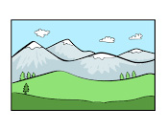


Mapscripts
Randomly generated elevation map.
Temperatures worked out from latitude and elevation.
Seasonal
Rainfall generated from temperatures and elevations.
To test climate generation functions we will pass in real elevation data and see what climate the script generates.

Slide 7
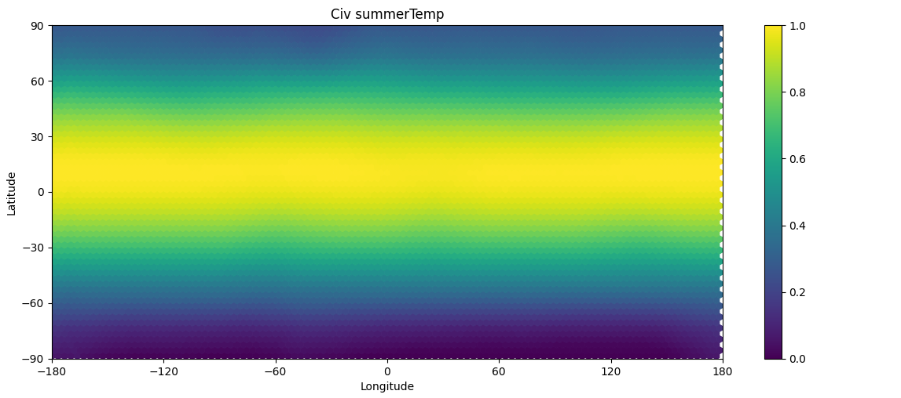
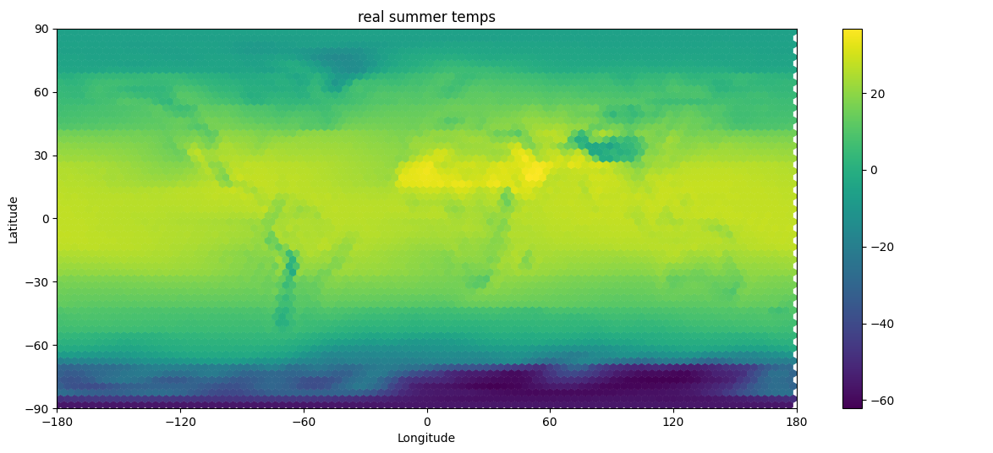
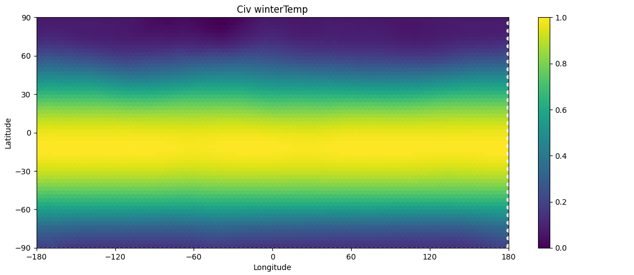
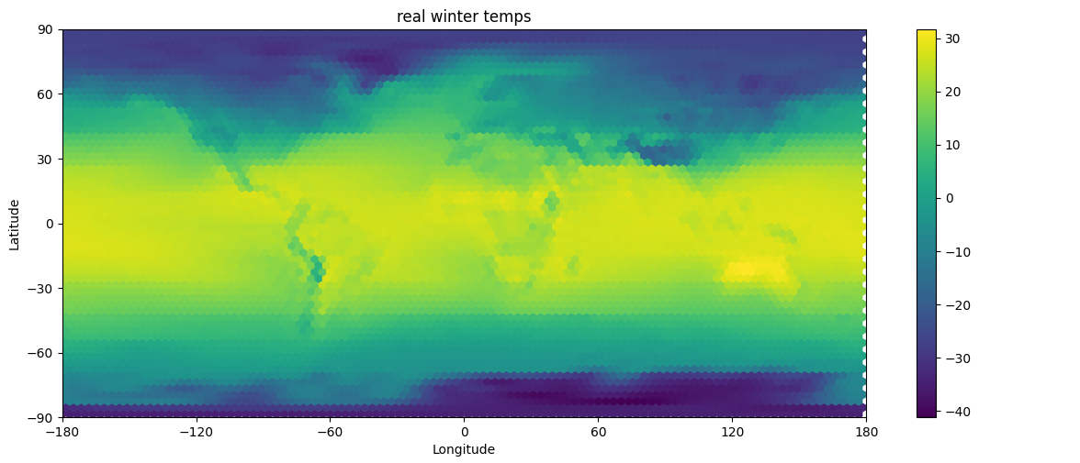
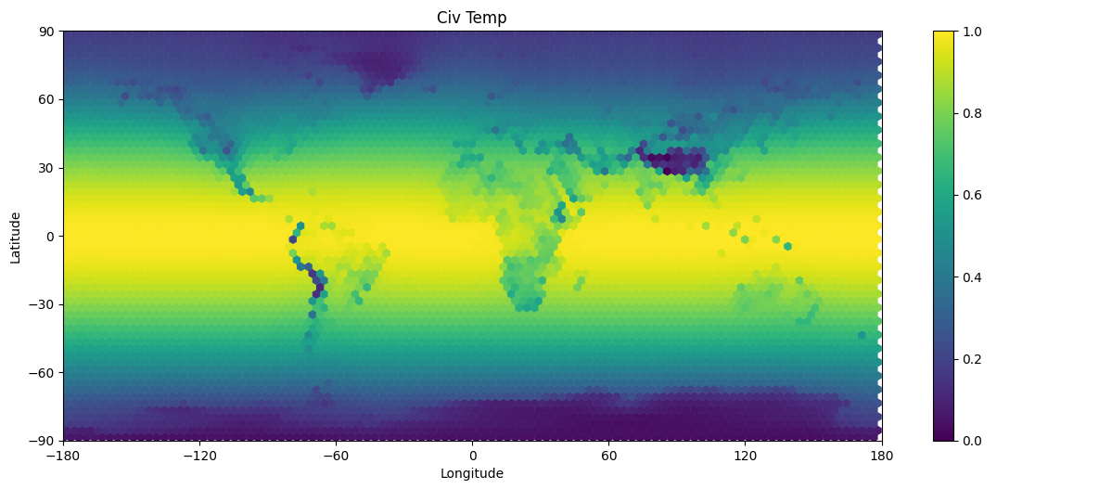
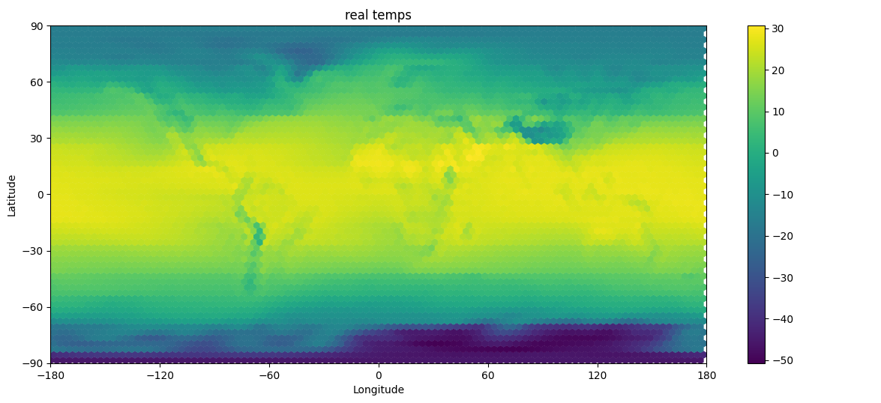
Temperature Map Comparison
Mapscript
Summer
Real
Winter
(Power BI Analysis)
Average

Slide 8
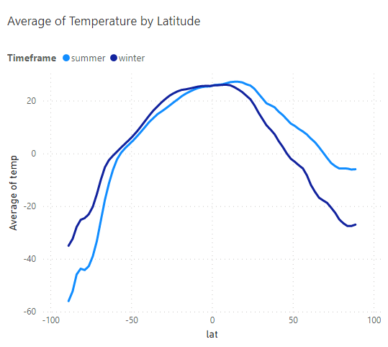
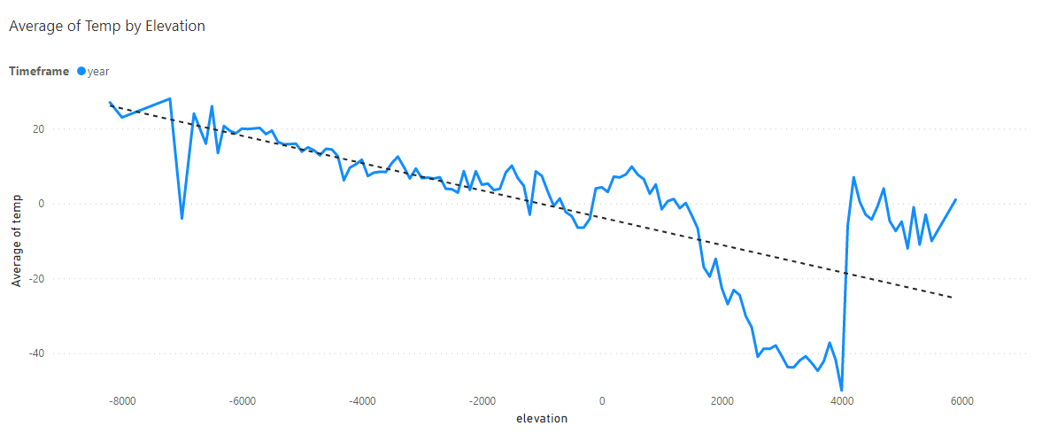
Modelling Temperature
Average of Temperature by Latitude follows cosine graph with offset:
Temp decreases proportionately with Elevation.
We can model this as: a * cos(lat + b) + c * elevation + d
where a, b, c, d are constants
Equivalent to: a* sin(b)*sin(lat) - a* cos(b)*cos(lat) + c * elevation + d
b is constant so this is: e* sin(lat) + f* cos(lat) + c* elevation + d
where e,f,c,d are constants we can determine.
.

Slide 9
Machine Learning
Used machine learning to find the best values for constants.
Separate constants for below and above sea level.
Separate for winter and summer but I then averaged the two (with -b for winter) in order to make the map symmetrical.
Offset (b) was 2.9 degrees for below sea and 8.5 degrees for above.
Updated the mapscript with the new formula.

Slide 10
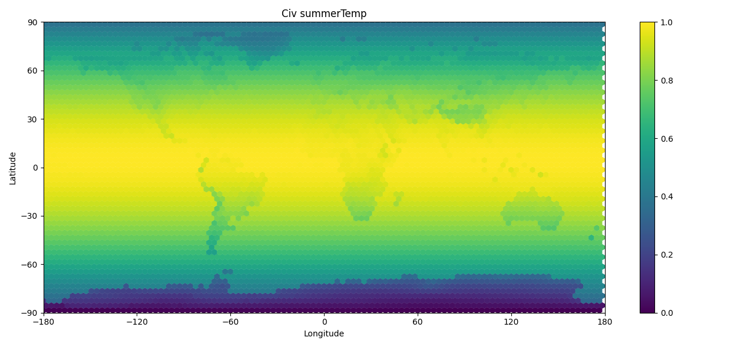
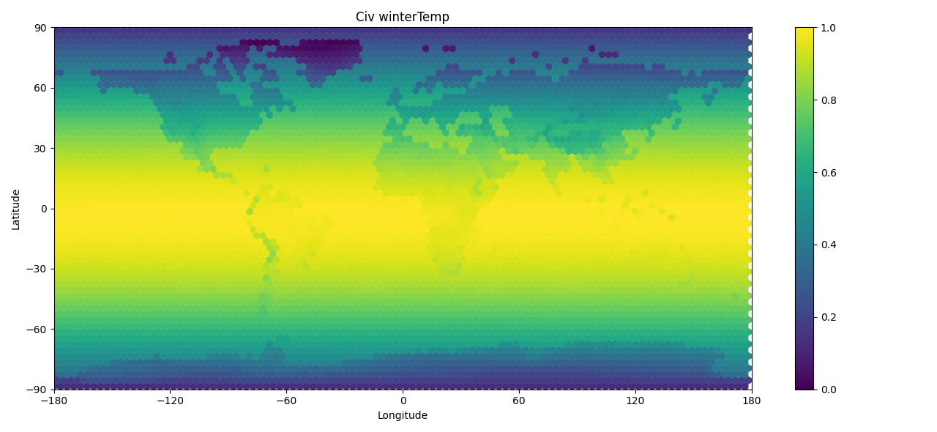
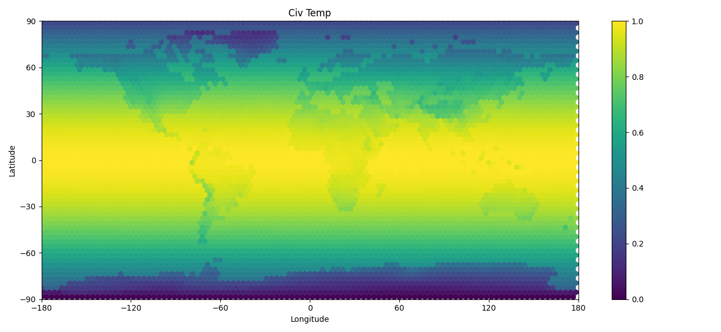
Updated Temperature Maps
Original Mapscript
Real
Summer
Updated
Winter
Yearly

Slide 11
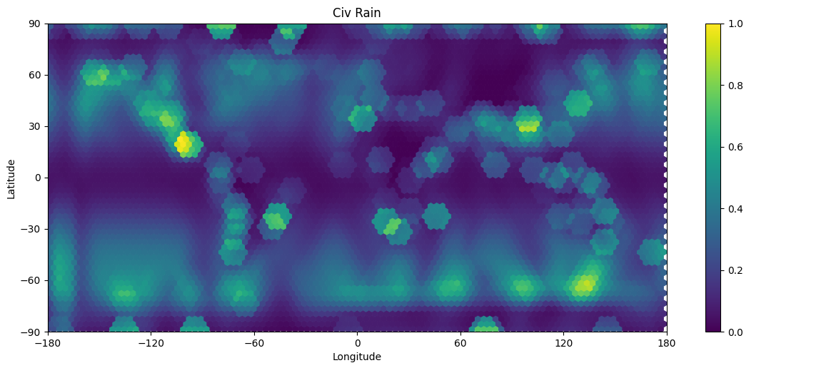
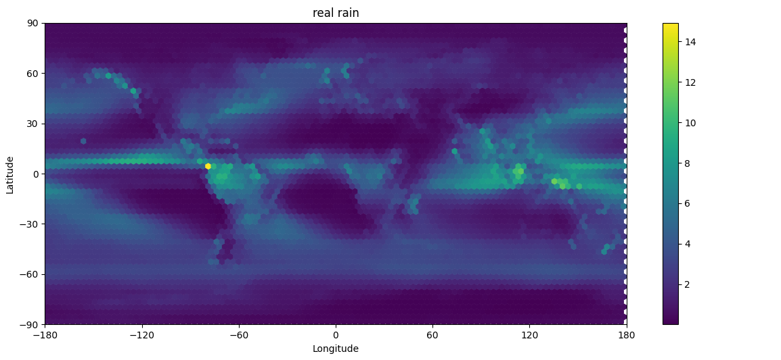
Comparing Yearly Rainfall Maps
Original Mapscript
Real
Rainfall is Complicated: No simple function on analysis
Will probably require some research into what causes rain.

Slide 12

Conclusions
It was possible to make a real earth map using data.
Map was probably ‘too’ accurate for a game.
Lots of options available for future maps.
Side project of being able to manipulate .nc files was time consuming but useful in the end.
Can update data sources with better data in the future.
We were able to analyse and improve the mapscript’s temperature function.
Rainfall will require some specific knowledge on weather patterns or higher-level distance-based ML.
In general I’m very happy with the results and look forward to continuing to work on it in the future, hopefully with some collaboration.

Slide 13
I hope you enjoyed my Presentation
Feel free to ask any questions.

